Slide 1
Packing cargo spaces efficiently
Group 8
Adam Eljasiak
Daniel Kaestner
Simon Wengeler
Raffaele Piccini
Nicola Gheza
Henri Viigimäe

Slide 2
CONTENTS
1. Assignment description
2. Assignment results
3. Implemented algorithms
4. Experiments and results
5. Conclusions

Slide 3
ASSIGNMENT DESCRIPTION

Slide 4
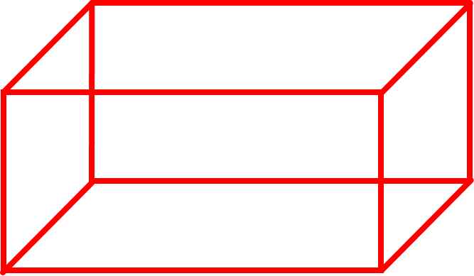
Application for solving three-dimensional knapsack problems
Three packages with certain values and a cargo space
A: 1.0 x 1.0 x 2.0 (m) with a value of 3
B: 1.0 x 1.5 x 2.0 (m) with a value of 4
C: 1.5 x 1.5 x 1.5 (m) with a value of 5
Cargo space: 16.5 x 2.5 x 4.0 (m)
16.5 (m)
4 (m)
2.5 (m)

Slide 5
ASSIGNMENT RESULTS

Slide 6
No solution to filling the entire cargo space with A,B and/or C packages has been found.
Best result found for maximizing a single packing: 240
Number of A packages: 30
Number of B packages :10
Number of C packages: 22

Slide 7
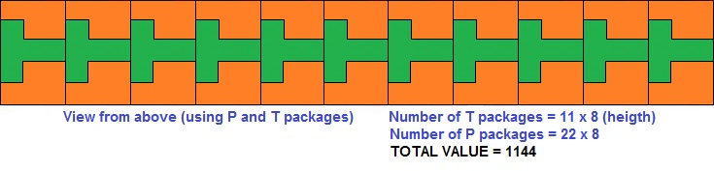
It is possible to fill the entire cargo space with L,P and/or T packages.
Best result found for maximizing a single packing: 1144

Slide 8
GREEDY ALGORITHM

Slide 9
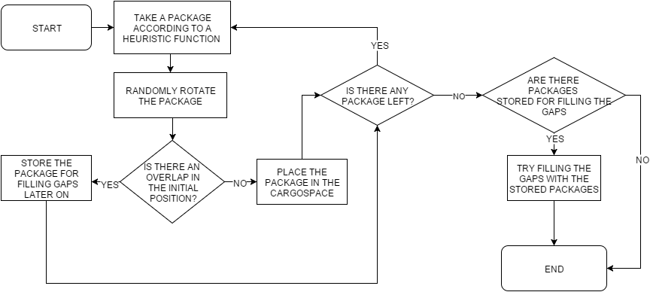

Slide 10
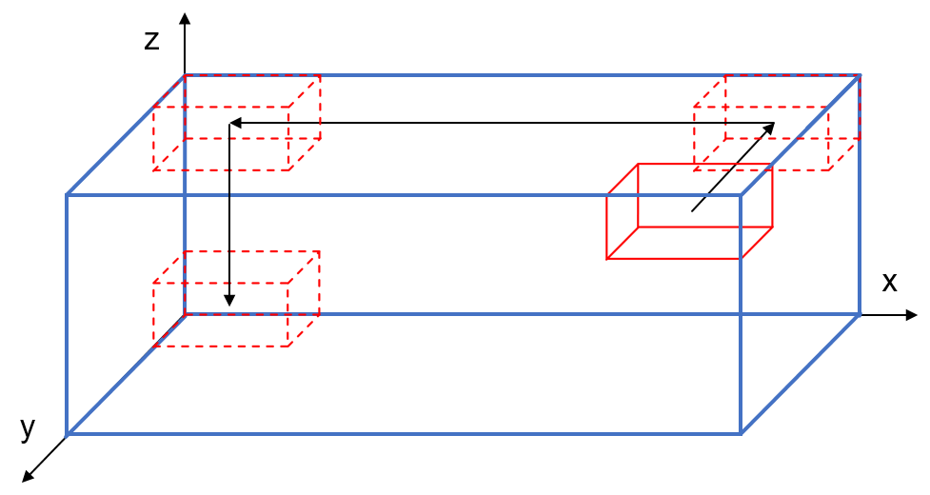

Slide 11
HILL CLIMBING ALGORITHM

Slide 12
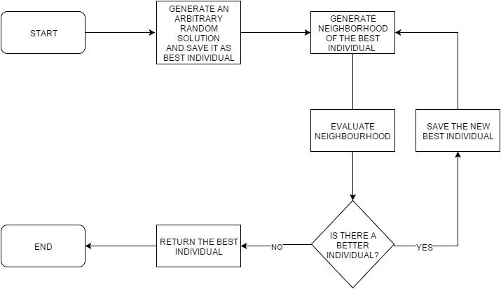

Slide 13
GENETIC ALGORITHM

Slide 14
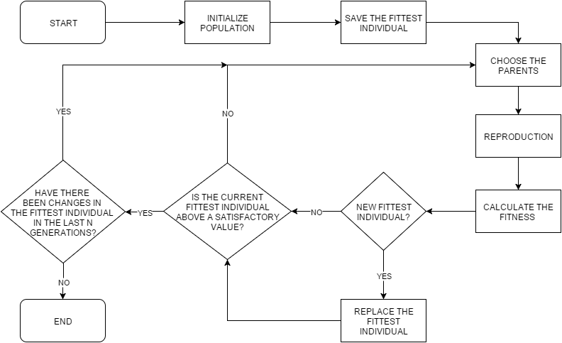

Slide 15
EXPERIMENTS AND RESULTS

Slide 16
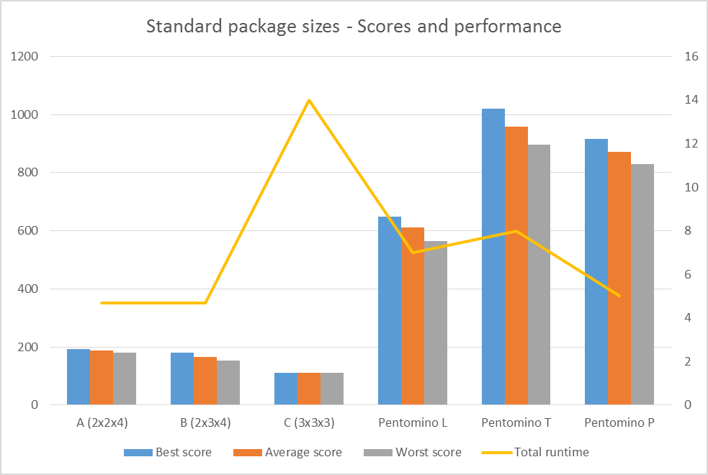
EXPERIMENTS AND RESULTS (GREEDY ALGORITHM)
Finding the best total value

Slide 17
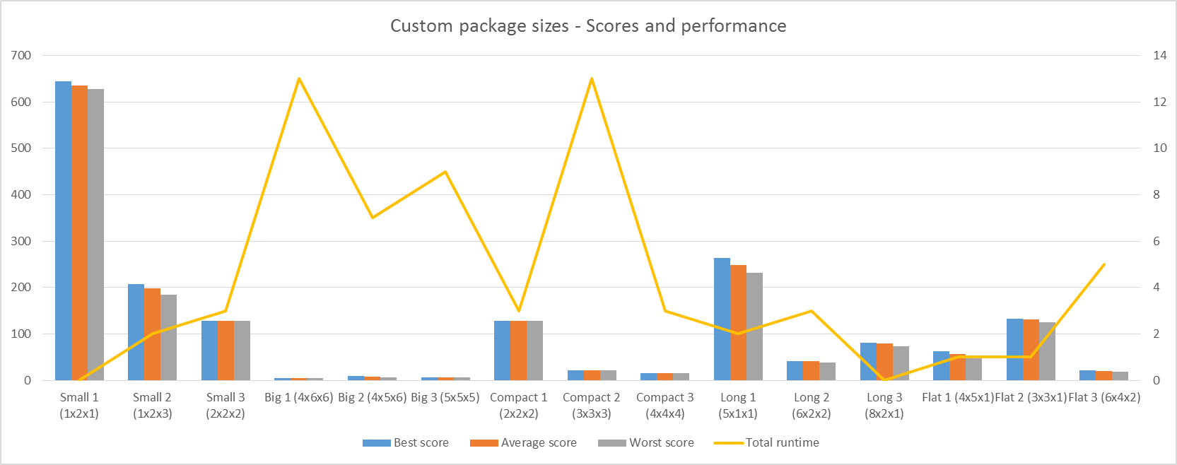

Slide 22
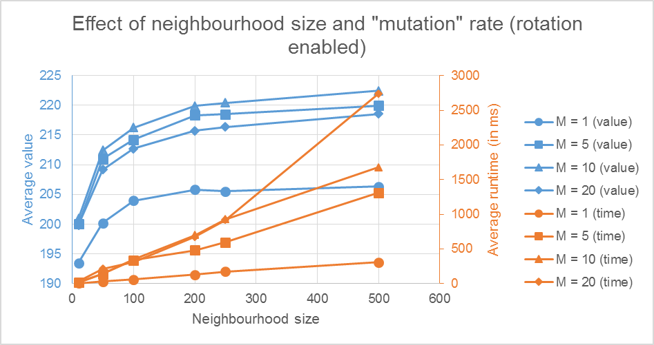
EXPERIMENTS AND RESULTS (HILL CLIMBING)

Slide 23
Mutation rate can increase average runtime.
Neighbourhood size is related to the performance.
Better results with rotation disabled.

Slide 24
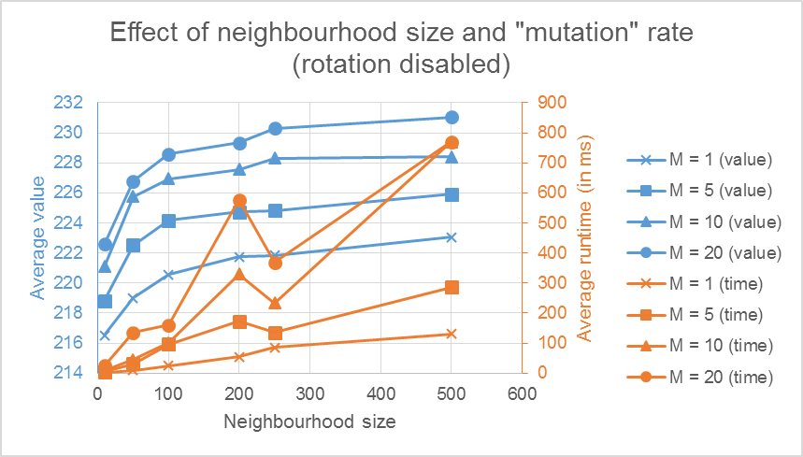

Slide 25
EXPERIMENTS AND RESULTS (GENETIC ALGORITHM)

Slide 26
Increase in population size yields better results
Affects the tournament selection method the most
Large increase in the average result achieved
Significant decrease in runtime

Slide 28
Increasing the mutation probability decreases the performance of the algorithm (both value and runtime wise)
This could be due to the way good solutions are achieved (no rotations)

Slide 29
EXTERNAL FACTORS
Experiments with different numbers of packages and new package types (e.g. small, big, long etc.)
Packages used have similar properties
All with value 1

Slide 30
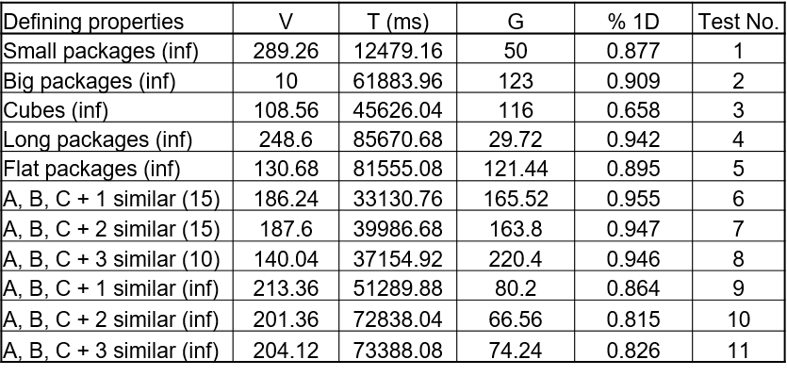

Slide 31
Performance worse than with standard packages
Still finds good solutions
Could probably adapt parameters to fit other packages better

Slide 32
CONCLUSIONS

Slide 33
Greedy algorithm is easy to implement and is easy to change
Hill climbing algorithm is fast and finds a good solution
Genetic algorithm gets closest to the optimal solution and has a decent runtime
GA struggles with high amounts of packages and different package types → can be improved by changing internal parameters

